Slide 1

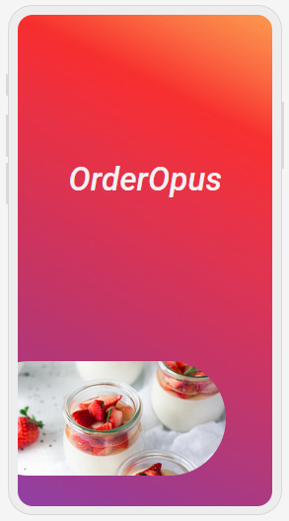
Presentation on OrderOpus

Slide 2
Meet our Team
Name: Sumaiya Man-Ara
Id: 221-15-4671
Name: Most. Nila Mony
Id: 221-15-4824
Name: Sumaiya Akter Nila
Id: 221-15-5181

Slide 3
Introduction
"OrderOpus" is an food service app which connects the restaurants with the consumers in a selected area within a certain radius.
This app only does the job of connection and it has no delivery service, the delivery should be done by the individual restaurants.

Slide 4
Features of App
User/Customer can-
Restaurants Owners can-
Browse Menu & Order Food
Track or manage food orders
Contact with delivery man
No extra commission will be taken on food
Manage Orders & Track orders
Cancel or change orders
Check new & Pending orders
Calculate delivery charges as per distance

Slide 5
OrderOpus
Front Page

Slide 6
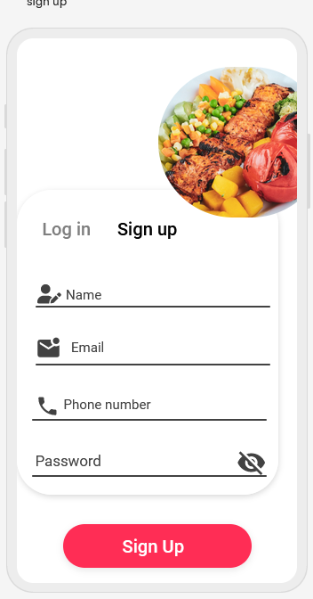
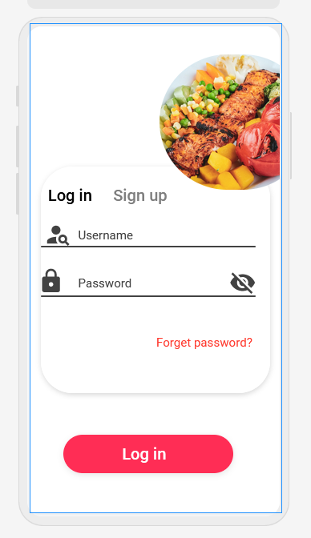
OrderOpus
Sign up page
Log in page

Slide 7
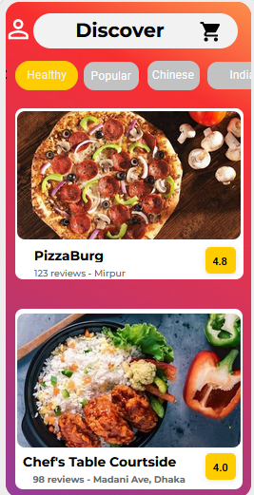
OrderOpus
Profile information
Home page

Slide 8
Advantages & Disadvantages
Advantages:
Disadvantages:
Customers & owners aren’t dependent on any 3rd party app.
Won't take any commission from the restaurants owners.
Food quality & quantity remains intact.
Users can read reviews and see restaurant ratings, helping them make informed decision about where to order from.
Don't have our own delivery system, restaurant's are responsible for the delivery.
Food services can contribute to increased packaging waste and carbon emissions due to the use of disposable containers and delivery vehicles.

Slide 9
Related Works
Foodpanda:
Hungrynaki:
https://play.google.com/store/apps/details?id=com.global.foodpanda.android
https://play.google.com/store/apps/details?id=com.hungrynaki.deliveryapp& hl=en&gl=US
Lackings:
Takes extra commission & platform fees.
Food quality and quantity decreases.

Slide 10

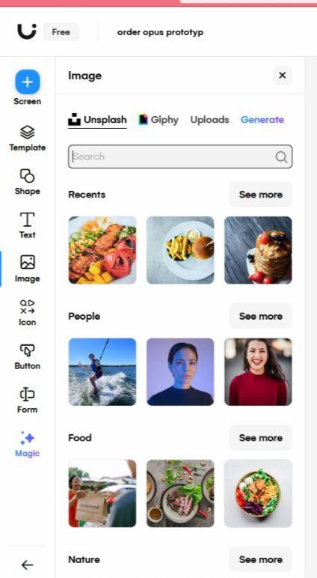
Used App & Tools
Used uizard app:
https://app.uizard.io/prototypes/mKAPb47oAJH3ZY6BgBqd
Used tools:
Image selecting-

Slide 11
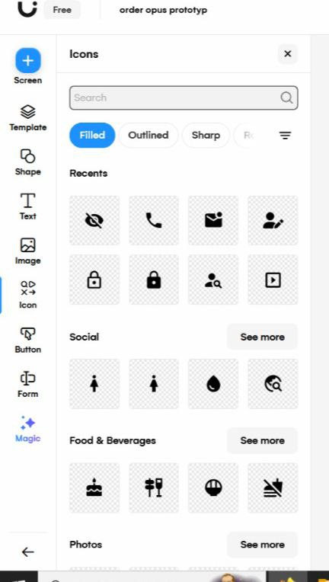
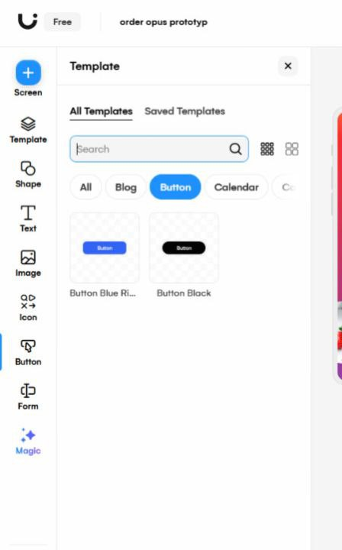
Used Tools
Icon selecting:
Button selecting:

Slide 12
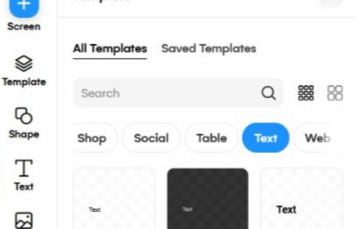
Used tools
Text Selecting:

Slide 13
Language Specifications
1.Html
2. Css
3. JavaScript

Slide 14
"OrderOpus" represents a significant advancement in the way we approach dining experiences and culinary services. With its user-friendly interface, diverse menu options, and seamless ordering process, this app has successfully addressed the evolving needs of both consumers and food establishments.
“
”

Slide 15
Thank you!

